Slide 1
ENHANCEMENT THROUGH DATA-DRIVEN ANALYSIS
ROAD SAFETY
Group 6
Tarun Sai Sunkara
Divya Sai Poluru
Junaid Mohammed

Slide 2
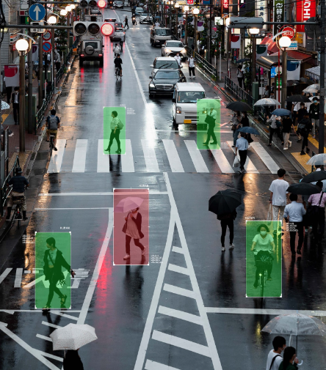
INTRODUCTION
Road traffic accidents in India pose significant threat to both lives and the economy.
3% of India's annual GDP, as reported by the Ministry of Road Transport and Highways.

Slide 3
About the Data Set
Dataset Overview
Categorization
01
02
Dimensions
Insights Goal
03
04
138,031 rows, 42 columns – a comprehensive repository of documented accidents.
Seven types: Identification, Characteristics, Location, Severity, Participants, Demographics, Vehicle Details, and Additional Categories.
Accident type, illumination status, speed zone, geographic coordinates, severity level, participant demographics, vehicle types – offers understanding of incidents.
Extract valuable patterns for traffic safety, law enforcement, and city planning by analyzing demographics, accident locations, severity, & societal factors.

Slide 4
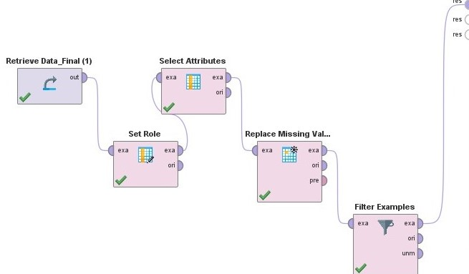
Data cleaning
Imported Dataset: Road traffic accidents dataset brought into RapidMiner.
Completeness: Addressed missing values for data integrity.
Consistency Measures: Implemented to ensure dataset consistency.
Format Standardization: Uniform formats for consistent analysis.

Slide 5
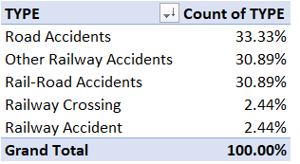
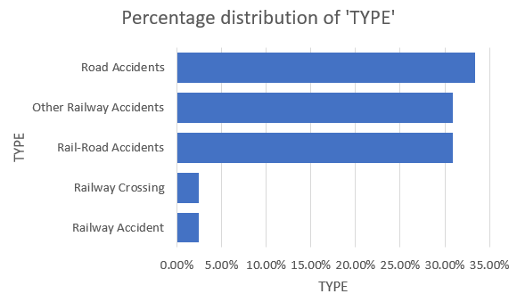
Exploratory Data Analysis (EDA): Data distributions and relationships.
Categorical Variables:
Encoded for numerical analysis.Ensured uniformity and numerical compatibility.
Outlier Handling:
Identified and addressed outliers for integrity.
Feature Scaling:
Applied techniques for fair variable comparison.

Slide 6
Proposed approach
Data Cleansing & Preprocessing
Data visualization
01
02
Initial steps for reliable data.
Address missing values and outliers.
Communicate findings effectively.
Utilize visual aids for clarity.
Machine learning models
04
03
Comprehensive Investigation
In-depth exploration of accident data.
Model-driven analysis for insights.
Decision Trees, K-nearest Neighbors, Clustering.
Identify crucial elements in accidents.
Foundation for Policies
05
06
Proactive Strategy
Inform policymaking with insights.
Targeted initiatives for reducing accidents and enhancing road safety.
Alleviate road safety concerns.
Benefit all relevant stakeholders.

Slide 7
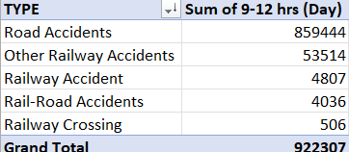
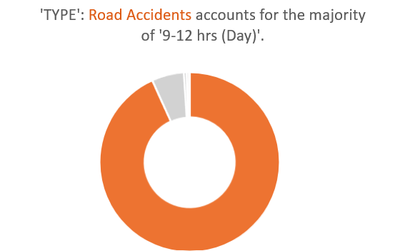
Problem definition
Conducting in-depth analysis of vehicular collisions due to their complexity.
Key Questions for Investigation:
Impact of alcohol on accident risk across different days.
Timing of most accidents during the day.
Types of faults leading to mishaps.
Comparison of accident rates between different vehicle types.
Assessment of changes in accident severity over past years.
Road Accident Types

Slide 8


Tools required
Used to build Used for Model Building and Model
Decision Tree Comparisons to predict future values.
For prediction
Of Future Analysis.

Slide 9
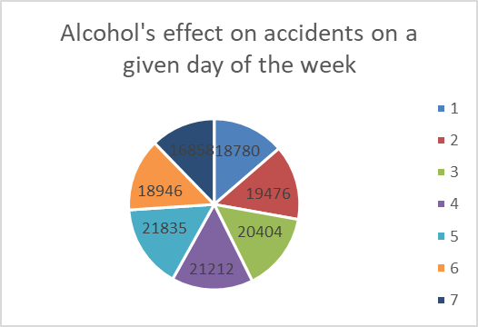
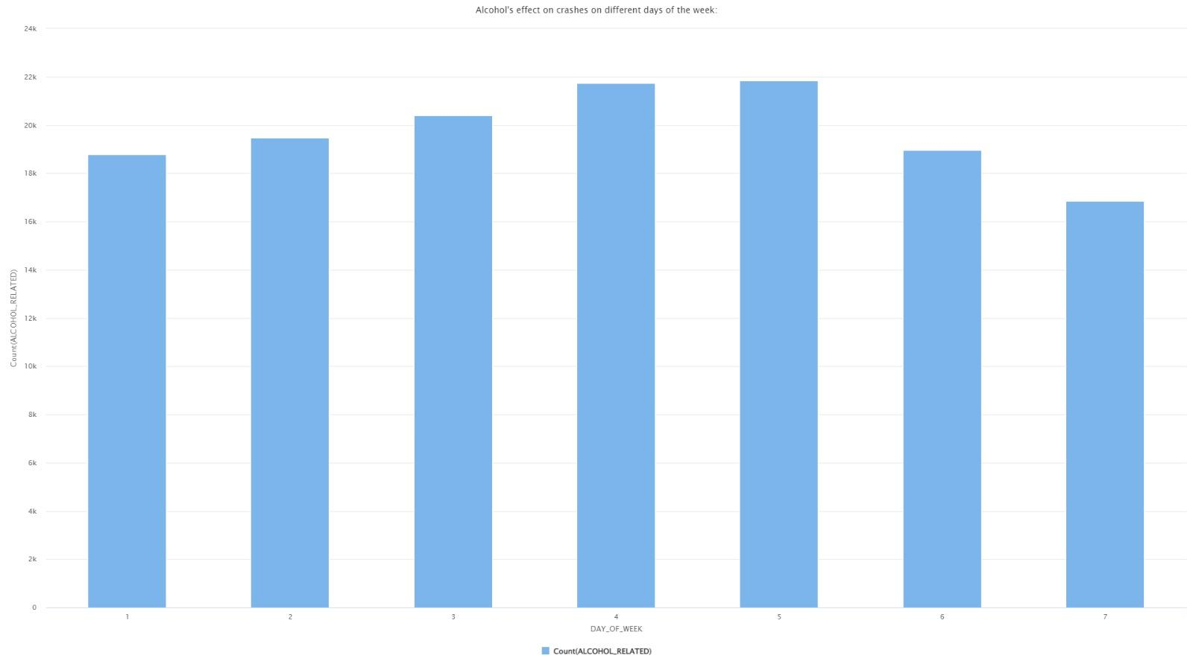
Visualization
Impact of alcohol on accident risk across different days.
Our analysis reveals key patterns in alcohol-related accidents by day of the week, guiding targeted interventions for enhanced road safety and contributing essential data to policy discussions.

Slide 10
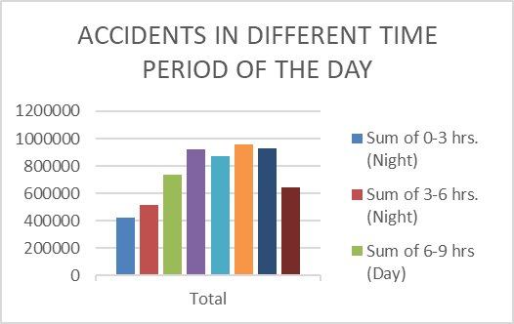
Visualization
Timing of most accidents during the day.
Peak accidents during 6-9 AM and 15-18 PM.
Lowest incidents between 12-15 PM.
Possible factors: rush hour traffic and driver fatigue.
Valuable for identifying high-risk times and developing accident reduction strategies.

Slide 11
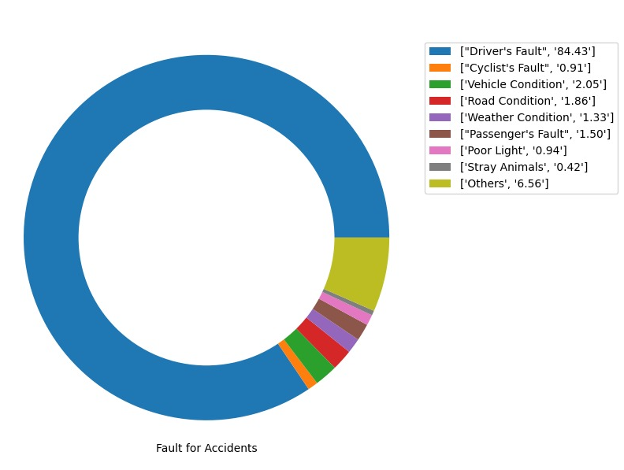
Visualization
Types of faults leading to mishaps.
Drivers responsible for over 80% of accidents.
Challenges popular assumption, highlighting driver accountability.
Acknowledges environmental factors like weather and visibility.

Slide 12
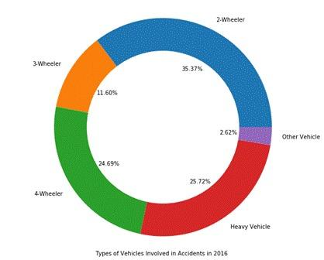
Visualization
Comparison of accident rates between different vehicle types.
Implement targeted safety measures for 2-wheelers due to their high accident rate.
Address specific challenges related to heavy vehicles given their significant contribution to accidents.
Investigate factors contributing to the lower accident rate for 4-wheelers to improve overall safety.

Slide 13
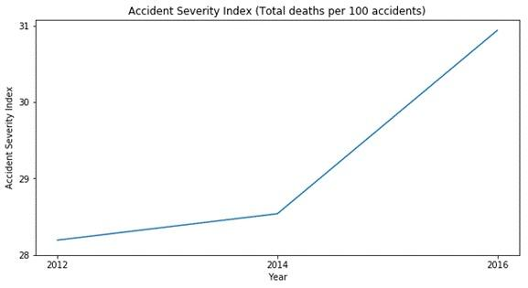
Visualization
Assessment of changes in accident severity over past years.
The graph illustrates a concerning trend of increasing accident severity over the years.
The insight serves as a crucial input for future model building, emphasizing the need for effective strategies to address the rising severity trend.

Slide 14
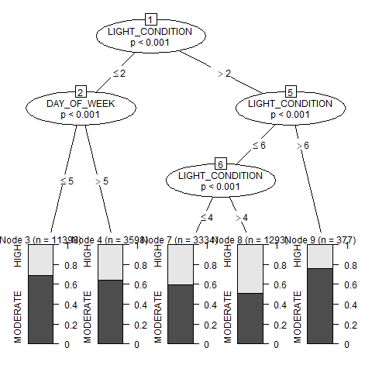
Model building
Decision Tree:
The decision tree analysis based on light conditions, day of the week, and severity index reveals that instances of high severity are associated with light conditions exceeding a value of 4.

Slide 15
Selecting best model
Speed Zone

Slide 16
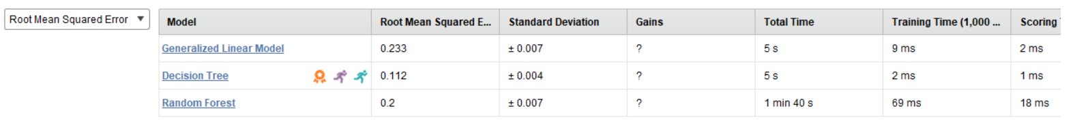
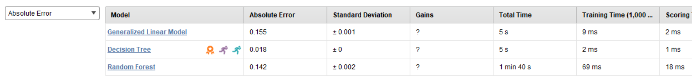
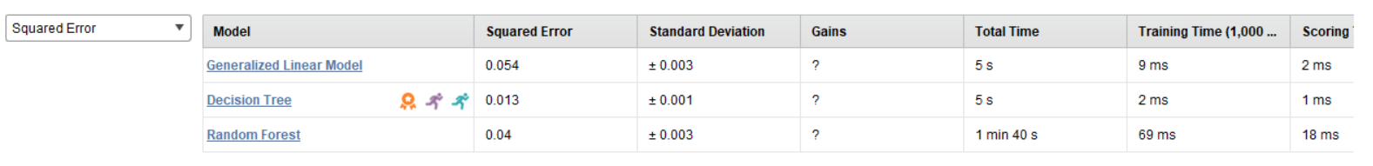
Severity

Slide 17
Limitations
Challenges Faced
External Factors
Steps Taken:
Data Incompleteness
Addressing missing or incomplete data.
Impact on the overall analysis and insights.
Model Limitations
Recognizing constraints of machine learning models.
Awareness of potential biases or inaccuracies.
External Variables
Acknowledging the influence of external factors.
Weather, road conditions, or socio-economic changes.
Scope Constraints
Clearly defining project boundaries.
Implications on the comprehensiveness of findings.
Addressing Challenges:
Strategies employed to handle data limitations.
Transparent communication of constraints.
Mitigation Efforts
Steps taken to mitigate model-related limitations.
Considerations for external variables.

Slide 18

fUTURE SCOPE
Broaden scope to include overseeding data and various accident types.
Construct intricate predictive models considering location, timings, days, and fault types.
Contribute to evidence-based policies for road safety enhancement.

Slide 19
CONCLUSION
Our analysis highlights road-related incidents and temporal patterns, contributing significantly to public safety policies.
Moving forward, we aim to predict accident patterns and proactively identify high-risk scenarios, advocating for a data-driven approach to enhance road safety comprehensively.

Slide 20
Thank you

